Slide 1
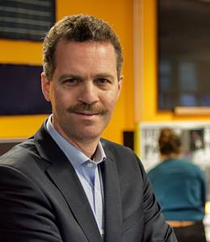


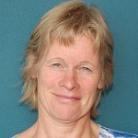
Electronics
EE3C11
(Introduction)
Rene van Swaaij Chris Verhoeven Anton Montagne Marion de Vlieger

Slide 2
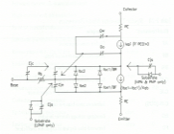
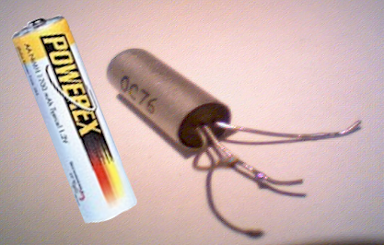
Building the “bridge”
Top-down design
Customer
Design Methodology
Specifications come from the top
Hardware comes from the bottom
Show-stoppers come from the bottom
Semiconductors
“Bottom-aware top-down design”
Circuits
Biased transistor
Bottom-up design

Slide 3
Schedule
Week | Date | Time |  | Location(s)
1 | Monday, February 13 | 8:45 | Physics 1 + small intro | Boole
 | Tuesday, February 14 | 10:45 | Elca 1 | Pi
 | Friday, February 17 | 10:45 | Physics 2 | Chip
2 | Monday, February 20 | 8:45 | Physics 3 | Boole
 | Tuesday, February 21 | 10:45 | Elca 2 | Pi
 | Friday, February 24 | 10:45 | Elca 3 | Chip
3 | Monday, February 27 | 8:45 | Elca 4 | Boole
 | Tuesday, February 28 | 10:45 | Elca 5 | Pi
 | Friday, March 3 | 10:45 | Elca 6 | Chip
4 | Monday, March 6 | 8:45 | Physics 4 | Boole
 | Tuesday, March 7 | 10:45 | Elca 7 | Pi
 | Friday, March 10 | 10:45 | Elca 8 | Chip
5 | Monday, March 13 | 8:45 | Physics 5 | Boole
 | Tuesday, March 14 | 10:45 | Elca 9 | Pi
 | Friday, March 17 | 10:45 | Elca 10 | CEG-Lecture Hall A (23.HG.0.23)
6 | Monday, March 20 | 8:45 | Physics 6 | Boole
 | Tuesday, March 21 | 10:45 | Elca 11 | Pi
 | Friday, March 24 | 10:45 | Elca 12 | Chip
7 | Monday, March 27 | 8:45 | Physics 7 | Boole
 | Tuesday, March 28 | 10:45 | Elca 13 | Pi
 | Friday, March 31 | 10:45 | Elca 14 | Chip
8 | Monday, April 3 | 8:45 | Physics 8 | Boole
 | Tuesday, April 4 | 10:45 | Elca 15 | Pi
 | Tuesday, April 11 | 10:45 | Physics 9 | Pi
9 | Wednesday, April 12 | 8:45 | Elca 16 (building transmitter/receiver) | Tellegen Hall practicumzaal 1
 | Friday, April 14 | 10:45 | Physics 10 | Chip
 | Friday, April 14 | 13:45 | Elca 17 (measuring transmitter/receiver) | Tellegen Hall practicumzaal 1
Top-down design
Semiconductors
Circuits
Bottom-up design

Slide 4
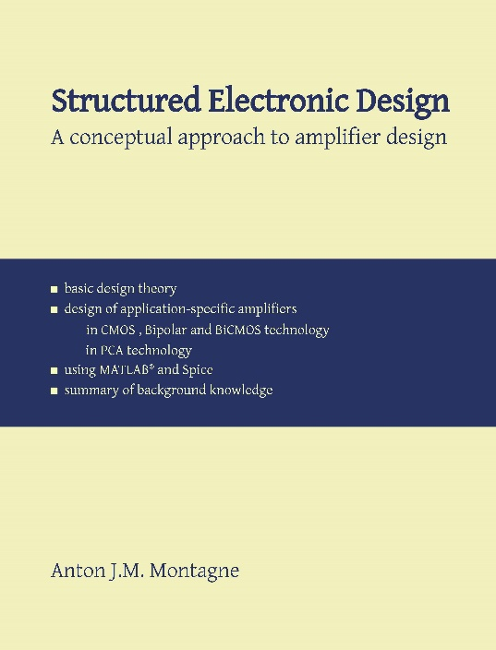

Books
Electronics
Structured Electronic Design
Edition 1.3
Anton Montagne
Download via Companion Website
https://analog-electronics.tudelft.nl/
Semiconductors
Semiconductor Physics and Devices; Basic Principles
Donald A. Neamen
McGraw-Hill International Edition, (4th edition)

Slide 5
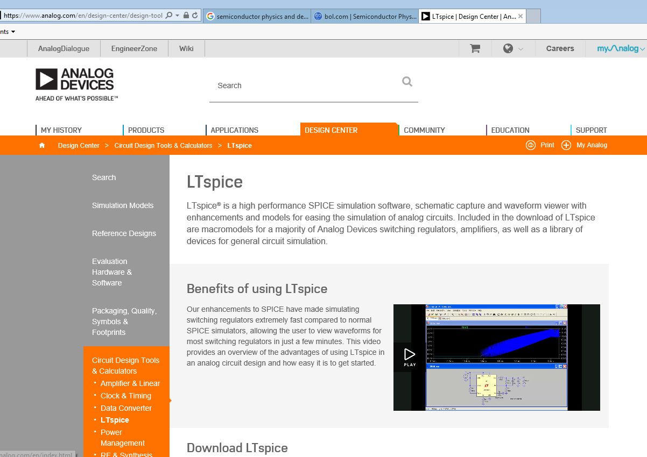
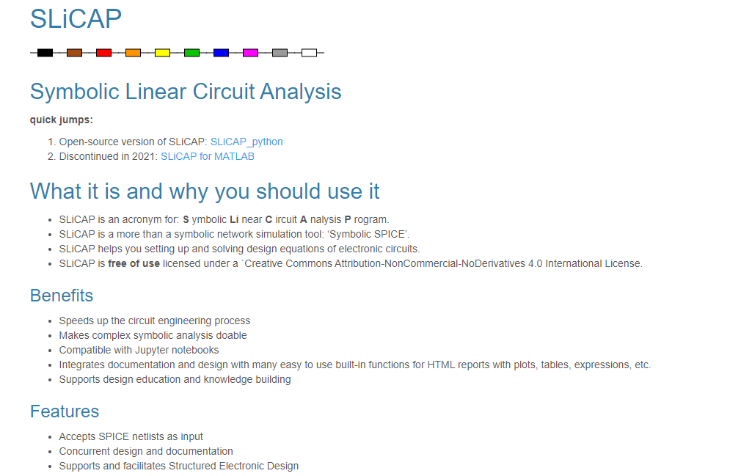
Software
LTspice®: Simulation, Schematic capture and Waveform viewer
SLiCAP : To set up and solve Design Equations of electronic circuits.
To create design documentation
(SLiCAP is a Python application: you need a laptop with e.g. Anaconda)

Slide 6
Exam
Multiple choice + some open questions that need short answers
Open book (course books, handouts, and slides)
1 bonus point for the exam obtained via a practical design.
(Remains valid for the re-sit)

Slide 7
Week | Date | Time |  | Location(s)
1 | Monday, February 13 | 8:45 | Physics 1 + small intro | Boole
 | Tuesday, February 14 | 10:45 | Elca 1 | Pi
 | Friday, February 17 | 10:45 | Physics 2 | Chip
2 | Monday, February 20 | 8:45 | Physics 3 | Boole
 | Tuesday, February 21 | 10:45 | Elca 2 | Pi
 | Friday, February 24 | 10:45 | Elca 3 | Chip
3 | Monday, February 27 | 8:45 | Elca 4 | Boole
 | Tuesday, February 28 | 10:45 | Elca 5 | Pi
 | Friday, March 3 | 10:45 | Elca 6 | Chip
4 | Monday, March 6 | 8:45 | Physics 4 | Boole
 | Tuesday, March 7 | 10:45 | Elca 7 | Pi
 | Friday, March 10 | 10:45 | Elca 8 | Chip
5 | Monday, March 13 | 8:45 | Physics 5 | Boole
 | Tuesday, March 14 | 10:45 | Elca 9 | Pi
 | Friday, March 17 | 10:45 | Elca 10 | CEG-Lecture Hall A (23.HG.0.23)
6 | Monday, March 20 | 8:45 | Physics 6 | Boole
 | Tuesday, March 21 | 10:45 | Elca 11 | Pi
 | Friday, March 24 | 10:45 | Elca 12 | Chip
7 | Monday, March 27 | 8:45 | Physics 7 | Boole
 | Tuesday, March 28 | 10:45 | Elca 13 | Pi
 | Friday, March 31 | 10:45 | Elca 14 | Chip
8 | Monday, April 3 | 8:45 | Physics 8 | Boole
 | Tuesday, April 4 | 10:45 | Elca 15 | Pi
 | Tuesday, April 11 | 10:45 | Physics 9 | Pi
9 | Wednesday, April 12 | 8:45 | Elca 16 (building transmitter/receiver) | Tellegen Hall practicumzaal 1
 | Friday, April 14 | 10:45 | Physics 10 | Chip
 | Friday, April 14 | 13:45 | Elca 17 (measuring transmitter/receiver) | Tellegen Hall practicumzaal 1
Top-down design
Semiconductors
Circuits

Slide 8
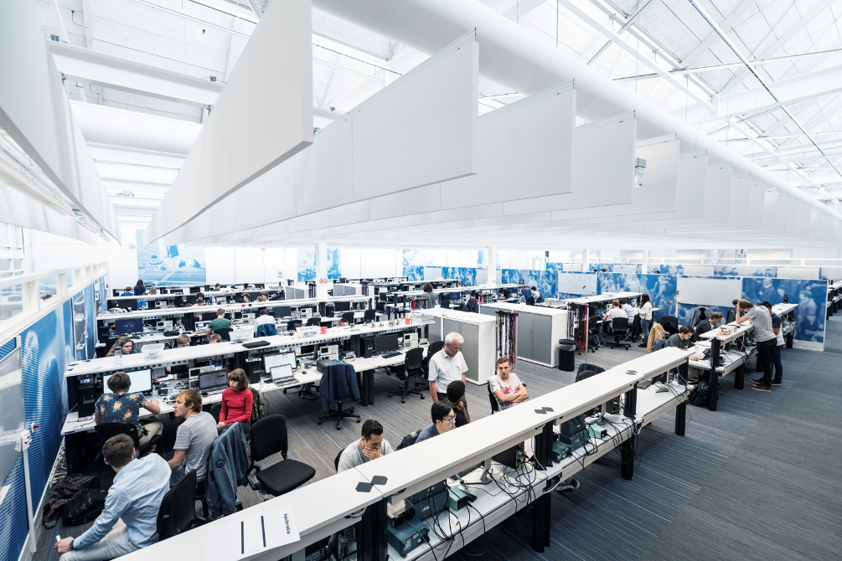
A
B
Week | Date | Time |  | Location(s)
1 | Monday, February 13 | 8:45 | Physics 1 + small intro | Boole
 | Tuesday, February 14 | 10:45 | Elca 1 | Pi
 | Friday, February 17 | 10:45 | Physics 2 | Chip
2 | Monday, February 20 | 8:45 | Physics 3 | Boole
 | Tuesday, February 21 | 10:45 | Elca 2 | Pi
 | Friday, February 24 | 10:45 | Elca 3 | Chip
3 | Monday, February 27 | 8:45 | Elca 4 | Boole
 | Tuesday, February 28 | 10:45 | Elca 5 | Pi
 | Friday, March 3 | 10:45 | Elca 6 | Chip
4 | Monday, March 6 | 8:45 | Physics 4 | Boole
 | Tuesday, March 7 | 10:45 | Elca 7 | Pi
 | Friday, March 10 | 10:45 | Elca 8 | Chip
5 | Monday, March 13 | 8:45 | Physics 5 | Boole
 | Tuesday, March 14 | 10:45 | Elca 9 | Pi
 | Friday, March 17 | 10:45 | Elca 10 | CEG-Lecture Hall A (23.HG.0.23)
6 | Monday, March 20 | 8:45 | Physics 6 | Boole
 | Tuesday, March 21 | 10:45 | Elca 11 | Pi
 | Friday, March 24 | 10:45 | Elca 12 | Chip
7 | Monday, March 27 | 8:45 | Physics 7 | Boole
 | Tuesday, March 28 | 10:45 | Elca 13 | Pi
 | Friday, March 31 | 10:45 | Elca 14 | Chip
8 | Monday, April 3 | 8:45 | Physics 8 | Boole
 | Tuesday, April 4 | 10:45 | Elca 15 | Pi
 | Tuesday, April 11 | 10:45 | Physics 9 | Pi
9 | Wednesday, April 12 | 8:45 | Elca 16 (building transmitter/receiver) | Tellegen Hall practicumzaal 1
 | Friday, April 14 | 10:45 | Physics 10 | Chip
 | Friday, April 14 | 13:45 | Elca 17 (measuring transmitter/receiver) | Tellegen Hall practicumzaal 1
BAP

Slide 9
Example

Slide 10
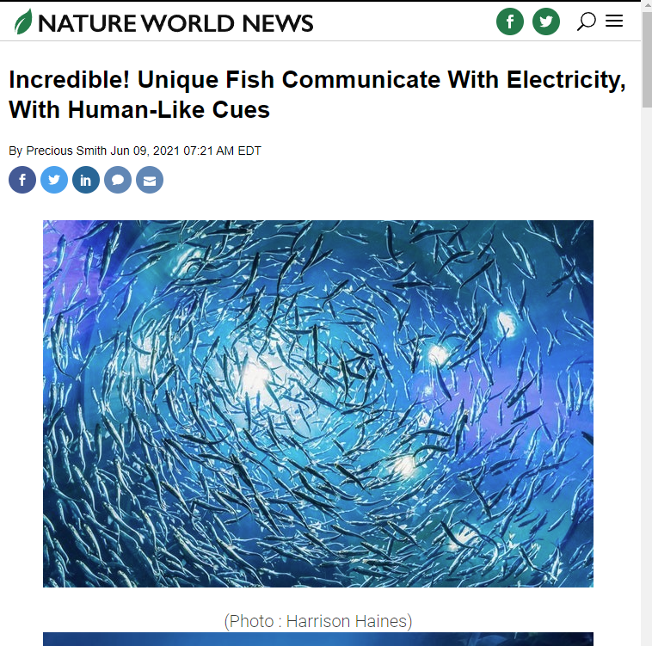
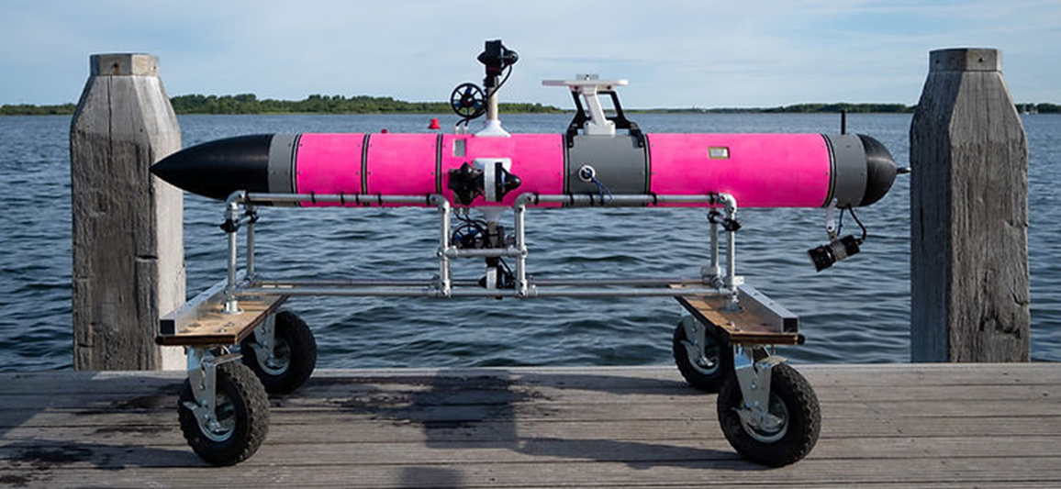
A
B
Week | Date | Time |  | Location(s)
1 | Monday, February 13 | 8:45 | Physics 1 + small intro | Boole
 | Tuesday, February 14 | 10:45 | Elca 1 | Pi
 | Friday, February 17 | 10:45 | Physics 2 | Chip
2 | Monday, February 20 | 8:45 | Physics 3 | Boole
 | Tuesday, February 21 | 10:45 | Elca 2 | Pi
 | Friday, February 24 | 10:45 | Elca 3 | Chip
3 | Monday, February 27 | 8:45 | Elca 4 | Boole
 | Tuesday, February 28 | 10:45 | Elca 5 | Pi
 | Friday, March 3 | 10:45 | Elca 6 | Chip
4 | Monday, March 6 | 8:45 | Physics 4 | Boole
 | Tuesday, March 7 | 10:45 | Elca 7 | Pi
 | Friday, March 10 | 10:45 | Elca 8 | Chip
5 | Monday, March 13 | 8:45 | Physics 5 | Boole
 | Tuesday, March 14 | 10:45 | Elca 9 | Pi
 | Friday, March 17 | 10:45 | Elca 10 | CEG-Lecture Hall A (23.HG.0.23)
6 | Monday, March 20 | 8:45 | Physics 6 | Boole
 | Tuesday, March 21 | 10:45 | Elca 11 | Pi
 | Friday, March 24 | 10:45 | Elca 12 | Chip
7 | Monday, March 27 | 8:45 | Physics 7 | Boole
 | Tuesday, March 28 | 10:45 | Elca 13 | Pi
 | Friday, March 31 | 10:45 | Elca 14 | Chip
8 | Monday, April 3 | 8:45 | Physics 8 | Boole
 | Tuesday, April 4 | 10:45 | Elca 15 | Pi
 | Tuesday, April 11 | 10:45 | Physics 9 | Pi
9 | Wednesday, April 12 | 8:45 | Elca 16 (building transmitter/receiver) | Tellegen Hall practicumzaal 1
 | Friday, April 14 | 10:45 | Physics 10 | Chip
 | Friday, April 14 | 13:45 | Elca 17 (measuring transmitter/receiver) | Tellegen Hall practicumzaal 1
BAP
https://www.lobster-robotics.com

Slide 11
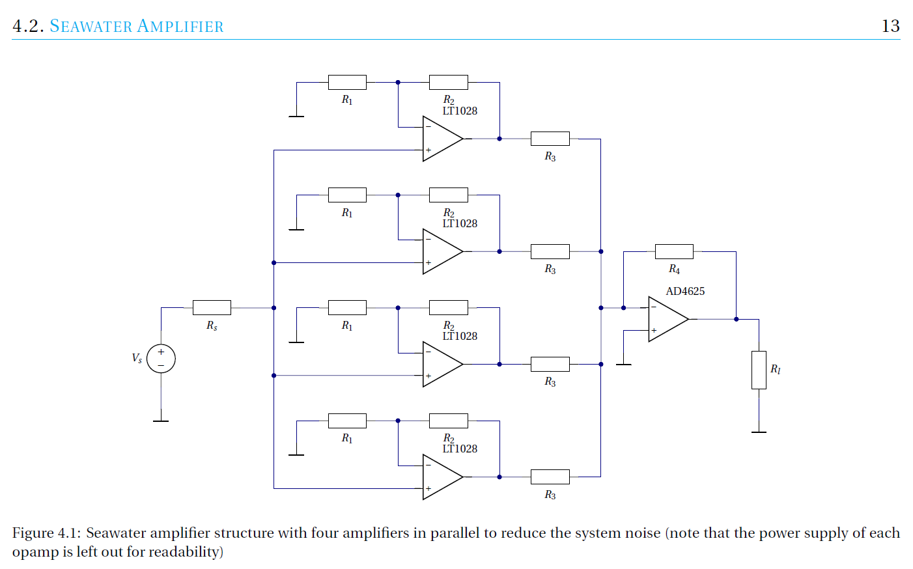
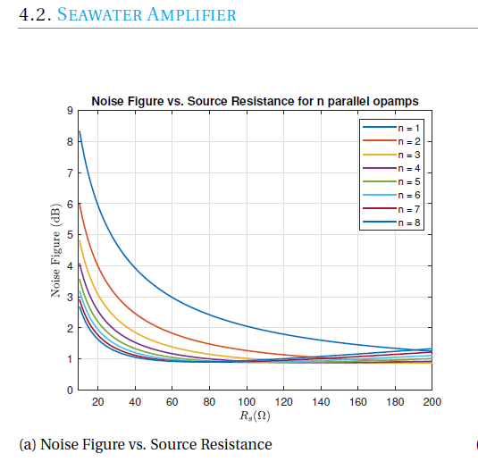
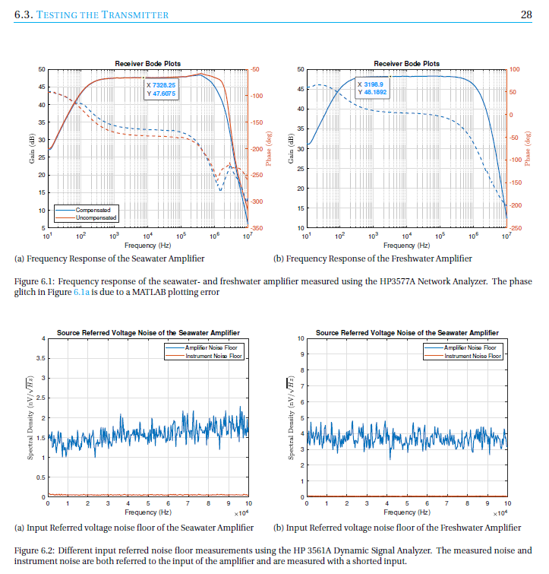

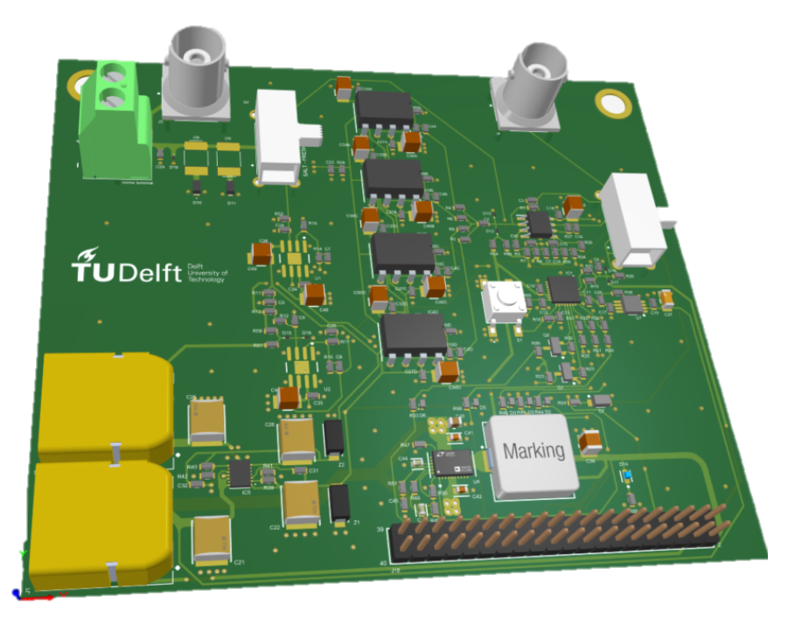
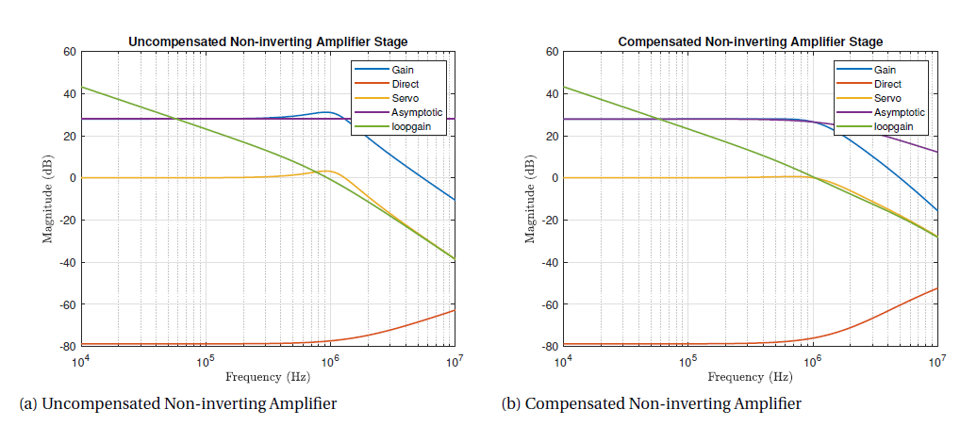
A
B
Week | Date | Time |  | Location(s)
1 | Monday, February 13 | 8:45 | Physics 1 + small intro | Boole
 | Tuesday, February 14 | 10:45 | Elca 1 | Pi
 | Friday, February 17 | 10:45 | Physics 2 | Chip
2 | Monday, February 20 | 8:45 | Physics 3 | Boole
 | Tuesday, February 21 | 10:45 | Elca 2 | Pi
 | Friday, February 24 | 10:45 | Elca 3 | Chip
3 | Monday, February 27 | 8:45 | Elca 4 | Boole
 | Tuesday, February 28 | 10:45 | Elca 5 | Pi
 | Friday, March 3 | 10:45 | Elca 6 | Chip
4 | Monday, March 6 | 8:45 | Physics 4 | Boole
 | Tuesday, March 7 | 10:45 | Elca 7 | Pi
 | Friday, March 10 | 10:45 | Elca 8 | Chip
5 | Monday, March 13 | 8:45 | Physics 5 | Boole
 | Tuesday, March 14 | 10:45 | Elca 9 | Pi
 | Friday, March 17 | 10:45 | Elca 10 | CEG-Lecture Hall A (23.HG.0.23)
6 | Monday, March 20 | 8:45 | Physics 6 | Boole
 | Tuesday, March 21 | 10:45 | Elca 11 | Pi
 | Friday, March 24 | 10:45 | Elca 12 | Chip
7 | Monday, March 27 | 8:45 | Physics 7 | Boole
 | Tuesday, March 28 | 10:45 | Elca 13 | Pi
 | Friday, March 31 | 10:45 | Elca 14 | Chip
8 | Monday, April 3 | 8:45 | Physics 8 | Boole
 | Tuesday, April 4 | 10:45 | Elca 15 | Pi
 | Tuesday, April 11 | 10:45 | Physics 9 | Pi
9 | Wednesday, April 12 | 8:45 | Elca 16 (building transmitter/receiver) | Tellegen Hall practicumzaal 1
 | Friday, April 14 | 10:45 | Physics 10 | Chip
 | Friday, April 14 | 13:45 | Elca 17 (measuring transmitter/receiver) | Tellegen Hall practicumzaal 1
☺
BAP

Slide 12

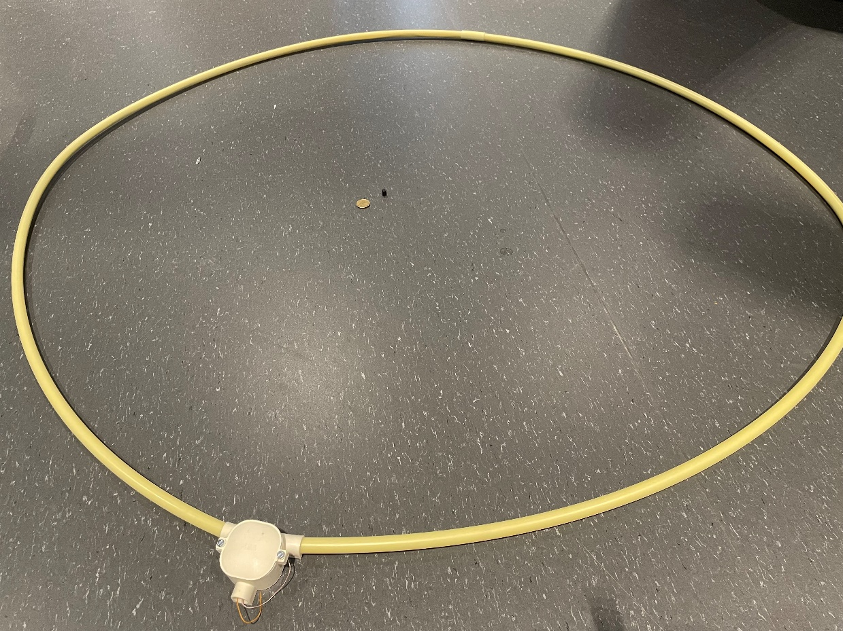
A
B
B
Week | Date | Time |  | Location(s)
1 | Monday, February 13 | 8:45 | Physics 1 + small intro | Boole
 | Tuesday, February 14 | 10:45 | Elca 1 | Pi
 | Friday, February 17 | 10:45 | Physics 2 | Chip
2 | Monday, February 20 | 8:45 | Physics 3 | Boole
 | Tuesday, February 21 | 10:45 | Elca 2 | Pi
 | Friday, February 24 | 10:45 | Elca 3 | Chip
3 | Monday, February 27 | 8:45 | Elca 4 | Boole
 | Tuesday, February 28 | 10:45 | Elca 5 | Pi
 | Friday, March 3 | 10:45 | Elca 6 | Chip
4 | Monday, March 6 | 8:45 | Physics 4 | Boole
 | Tuesday, March 7 | 10:45 | Elca 7 | Pi
 | Friday, March 10 | 10:45 | Elca 8 | Chip
5 | Monday, March 13 | 8:45 | Physics 5 | Boole
 | Tuesday, March 14 | 10:45 | Elca 9 | Pi
 | Friday, March 17 | 10:45 | Elca 10 | CEG-Lecture Hall A (23.HG.0.23)
6 | Monday, March 20 | 8:45 | Physics 6 | Boole
 | Tuesday, March 21 | 10:45 | Elca 11 | Pi
 | Friday, March 24 | 10:45 | Elca 12 | Chip
7 | Monday, March 27 | 8:45 | Physics 7 | Boole
 | Tuesday, March 28 | 10:45 | Elca 13 | Pi
 | Friday, March 31 | 10:45 | Elca 14 | Chip
8 | Monday, April 3 | 8:45 | Physics 8 | Boole
 | Tuesday, April 4 | 10:45 | Elca 15 | Pi
 | Tuesday, April 11 | 10:45 | Physics 9 | Pi
9 | Wednesday, April 12 | 8:45 | Elca 16 (building transmitter/receiver) | Tellegen Hall practicumzaal 1
 | Friday, April 14 | 10:45 | Physics 10 | Chip
 | Friday, April 14 | 13:45 | Elca 17 (measuring transmitter/receiver) | Tellegen Hall practicumzaal 1
Design, build, test
onus

Slide 13
Bottom-up design
Week | Date | Time |  | Location(s)
1 | Monday, February 13 | 8:45 | Physics 1 | Boole
 | Tuesday, February 14 | 10:45 | Elca 1 | Pi
 | Friday, February 17 | 10:45 | Physics 2 | Chip
2 | Monday, February 20 | 8:45 | Physics 3 | Boole
 | Tuesday, February 21 | 10:45 | Elca 2 | Pi
 | Friday, February 24 | 10:45 | Elca 3 | Chip
3 | Monday, February 27 | 8:45 | Elca 4 | Boole
 | Tuesday, February 28 | 10:45 | Elca 5 | Pi
 | Friday, March 3 | 10:45 | Elca 6 | Chip
4 | Monday, March 6 | 8:45 | Physics 4 | Boole
 | Tuesday, March 7 | 10:45 | Elca 7 | Pi
 | Friday, March 10 | 10:45 | Elca 8 | Chip
5 | Monday, March 13 | 8:45 | Physics 5 | Boole
 | Tuesday, March 14 | 10:45 | Elca 9 | Pi
 | Friday, March 17 | 10:45 | Elca 10 | CEG-Lecture Hall A (23.HG.0.23)
6 | Monday, March 20 | 8:45 | Physics 6 | Boole
 | Tuesday, March 21 | 10:45 | Elca 11 | Pi
 | Friday, March 24 | 10:45 | Elca 12 | Chip
7 | Monday, March 27 | 8:45 | Physics 7 | Boole
 | Tuesday, March 28 | 10:45 | Elca 13 | Pi
 | Friday, March 31 | 10:45 | Elca 14 | Chip
8 | Monday, April 3 | 8:45 | Physics 8 | Boole
 | Tuesday, April 4 | 10:45 | Elca 15 | Pi
 | Tuesday, April 11 | 10:45 | Physics 9 | Pi
9 | Wednesday, April 12 | 8:45 | Elca 16 (building transmitter/receiver) | Tellegen Hall practicumzaal 1
 | Friday, April 14 | 10:45 | Physics 10 | Chip
 | Friday, April 14 | 13:45 | Elca 17 (measuring transmitter/receiver) | Tellegen Hall practicumzaal 1
Semiconductors
Circuits

